Slide 1
Applets and 2-D Graphics
Session 16

Slide 2
Review
A File class is used to access the file system.
InputStream is an abstract class that defines how data is received. The OutputStream class is also abstract. It defines the way in which output is written to streams.
ByteArrayInputStream creates an input stream from the memory buffer while ByteArrayOutputStream creates an output stream on a byte array.
A buffer is a temporary storage area for data. Java uses buffered input and output to temporarily cache data read from or written to a stream.
The RandomAccessFile class provides the capability to perform I/O to specific locations within a file.
Character streams provide a way to handle character oriented input/output operations.
Reader and Writer classes are abstract classes that support reading and writing of Unicode character streams.

Slide 3
Objectives
Explain the Abstract Window Toolkit (AWT)
Define an Applet
Differentiate between Java Applications and Java Applets
Create an Applet
Identify how parameters are passed to Applets
Discuss event handling with Applets
Explain Classes such as
  Graphics class
  Font class
  FontMetrics class
  Color class

Slide 4
The AWT Toolkit
The Abstract Window Toolkit (AWT) is a set of Java classes that allow the programmer to create a Graphical User Interface (GUI) and accept user input through the keyboard and the mouse.
They are heavyweight components of Java Foundation Classes (JFC). The java.awt package contains all classes for creating user interfaces and for painting graphics and images.
The AWT has several subsystems that support the development and creation of an attractive and efficient GUI. The subsystems include:
    Containers
    Components
    Layout managers
    Graphics and drawing capabilities
    Fonts
    Events

Slide 5


Applets
An Applet is a Java program that can be embedded in an HTML page and executed on a Java enabled browser.
Created by subclassing from the java.applet.Applet class.
Examples of Java enabled web browsers are Internet Explorer
and Netscape Communicator.

Slide 6
Difference between
Applets and Applications 2-1
An Applet is basically designed for deploying on the web.
An application is designed to work as a standalone program.
Applets are created by extending the java.applet.Applet class.
There is no such constraint for an application.
Applets run on any browser.
Applications run using Java interpreter.

Slide 7
Difference between
Applets and Applications 2-2
Execution of Applets begins with the init() method.
Execution of applications begins with main() method.
Applet must contain at least one public class failing which the compiler reports an error. It is not mandatory to declare main() for an applet.
In case of application, main() has to be included in a public class.
Output to an Applet’s window is done by using different AWT methods such as drawString(). In case of an application System.out.println() method is used.

Slide 8
Life cycle of an Applet 3-1
Life cycle of an object specifies stages, which the object has to pass right from its creation until it is destroyed.
An Applet defines its structure from four events that take place during execution.
For each event, a method is automatically called.

Slide 9
Life cycle of an Applet 3-2
The methods are as follows:
  init(): called during initialization.
  start(): starts the Applet once it is initialized.
  stop(): used to pause the execution of an Applet.
  destroy(): used to destroy the Applet.
  paint():used to display a line, text or an image on the screen.
  repaint() : used to paint the Applet again after it has been drawn once.

Slide 10
Life cycle of an Applet 3-3
Start state
Redraw Applet
Destroy Applet
init( )
Applet Born
start( )
paint( )
stop( )
destroy( )
Initialization state
Applet Working
Applet Displayed
Idle State
Applet Destroyed

Slide 11
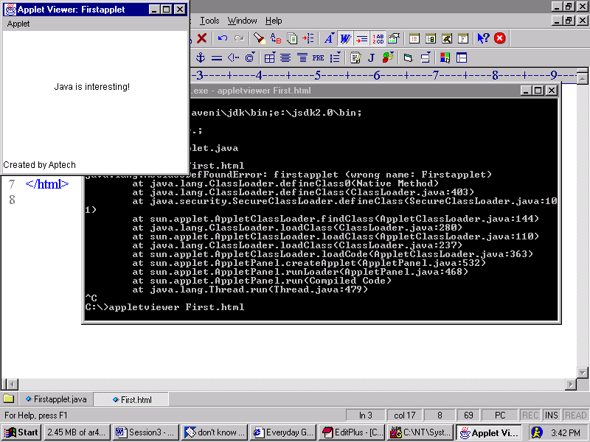
A simple Applet
import java.awt.*;
import java.applet.*;
public class FirstApplet extends Applet
{
String str;
public void init()
{
str = "Java is interesting!";
}
public void paint(Graphics g)
{
g.drawString(str, 70, 80);
}
}
Output

Slide 12
Creating an Applet
An Applet is compiled using the Java compiler: javac
  javac Firstapplet.java
Create an HTML page to display the Applet
  <html>
  <appletcode=Firstapplet width=200 height=200>
  </applet>
  </html>
Then type the following at command prompt:
  appletviewer abc.html where abc.html is the name of
  the html file.

Slide 13
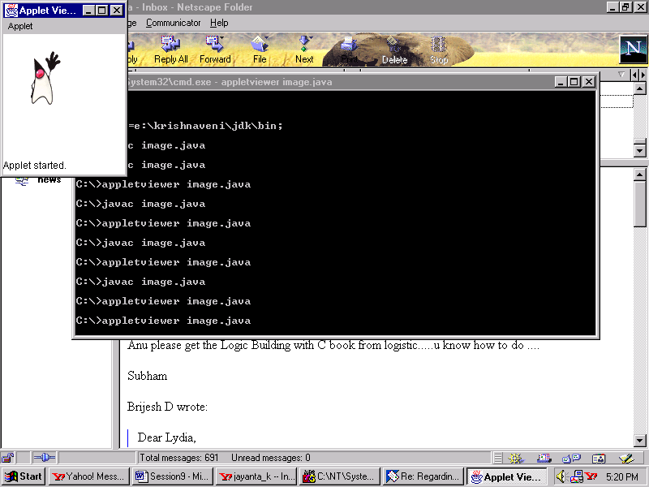
Displaying images using Applets 2-1
/*
<applet code = DisplayImage width = 200 height = 200>
</applet>
*/
import java.awt.*;
import java.applet.*;
public class DisplayImage extends Applet
{
Image img;
public void init()
{
img = getImage(getCodeBase(),"duke.gif");
}
public void paint(Graphics g)
{
g.drawImage(img,20,20,this);
}
}
Output

Slide 14
Displaying images using Applets 2-2
To display images, we need to make use of the Image and Graphics classes.
getCodeBase() method gets the base URL of the Applet.
getImage() method returns an Image object, which can be drawn on the screen.
drawImage() takes four parameters – Image object, location in terms of x and y coordinates and an object of type ImageObserver.

Slide 15
Passing parameters
Parameters allow the user to control certain factors of the Applet.
Parameters are passed to the Applet using the <param> tag in the HTML file.
Parameter value is retrieved in the Applet using the getParameter() method, which returns a string.

Slide 16
Example
import java.awt.*;
import java.applet.*;
public class ImageDemo extends Applet
{
Image img;
public void init()
{
img = getImage(getCodeBase(),imagename);
}
public void paint(Graphics g)
{
g.drawImage(img,20,20,this);
}
}
<html>
<applet code = ImageDemo width = 150 height = 150>
<param name = "image" value = "duke.gif">
</applet>
</html>

Slide 17
Graphics, Colors, and Fonts
Any GUI based program without images or colors looks dull and lifeless.
To enhance the program’s appearance, it is recommended that we use images wherever possible.
General procedure to draw images would be:
  Obtain the URL or path of the image to be displayed.
  Decide upon the position (coordinates) at which image is to be displayed.
  Supply all this information using an appropriate method.

Slide 18
Graphics class
Drawing operations are accomplished using this class.
Apart from text, it is possible to draw images, rectangles, lines, polygons and various other graphical representations.
Graphics class is a part of the java.awt package.
It has to be imported into the program.

Slide 19
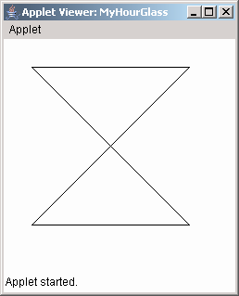
Example 2-2
/*
<applet code=Painting width=400 height=400>
</applet>
*/
import java.awt.*;
import java.applet.*;
public class MyHourGlass extends Applet {
public void paint(Graphics g)
{
int numx[] = {30, 200, 30, 200, 30};
int numy[] = {30, 30, 200, 200, 30};
int num = 5;
g.drawPolygon(numx, numy, num);
}
}
Output

Slide 20
Font class
java.awt.Font class is used to set or retrieve fonts.
One of the constructors of the Font class is:
  public Font(String name, int style, int pointsize)
    name can be “Times New Roman”, “Arial” and so on.
    style can be Font.PLAIN, Font.BOLD, Font.ITALIC
    pointsize for fonts can be 11,12,14,16 and so on.

Slide 21
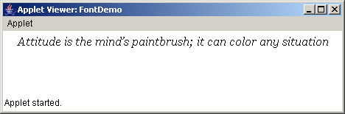
Example
/*
/*<applet code = FontDemo width = 400 height = 400>
</applet>*/
import java.applet.*;
import java.awt.*;
public class FontDemo extends Applet
{
public void paint(Graphics g)
{
String quote = "Attitude is the mind’s paintbrush; it can color any situation ";
Font objFont = new Font("Georgia",Font.ITALIC,16);
g.setFont(objFont);
g.drawString(quote,20,20);
}
}
Output

Slide 22
FontMetrics class
At times, it is necessary to know the attributes of fonts used within a program.
In such a case, the FontMetrics class proves useful.
Commonly used methods of FontMetrics class:
  int stringWidth(String s) – returns full width of string.
  int charWidth(char c) – returns width of that character.
  int getHeight() – returns total height of the font.

Slide 23
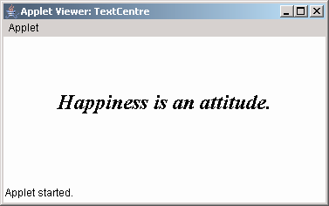
Example
Output
/*
<applet code= TextCentre width=400 height=400>
</applet>*/
import java.applet.*;
import java.awt.*;
public class TextCentre extends Applet
{
public void paint(Graphics g)
{
String myquote = "Happiness is an attitude.";
Font objFont = new Font("Times New Roman" , Font.BOLD|Font.ITALIC , 24);
FontMetrics fm = getFontMetrics(objFont);
g.setFont(objFont);
int numx = (getSize().width - fm.stringWidth(myquote))/2;
int numy = getSize().height/2;
g.drawString(myquote,numx,numy);
}
}

Slide 24
Determining Available Fonts
We should always know which fonts are available on the machine.
We can use a method called getAvailableFontFamilyNames() defined in the GraphicsEnvironment class.
The syntax of the method is as follows:
  String[] getAvailableFontFamilyNames(): returns an array of Strings that contains the names of the available font families.
  Font[] getAllFonts(): returns an array of Font objects for all the available fonts.

Slide 25
Color class
java.awt.Color class is used to add color to applications and Applets.
Objects of Color class can be constructed as shown :
  Color a = new Color(255,255,0);
  Color b = new Color(0.907F,2F,0F);
To change or set colors for a component :
  abstract void setColor(Color) of Graphics class
  void setForeground(Color) of Component class ,inherited by various components.
  void setBackground(Color) of Component class ,inherited by various components.

Slide 26
Summary 2-1
An Applet is a Java program that can be executed with the help of a Java enabled browser.
Every user-defined Applet must extend the java.applet.Applet class.
A user-defined Applets inherits all the methods of Applet class.
<applet>..</applet> tags are used within an HTML file to embed a class file.
The default layout for an Applet is FlowLayout.
Images can be drawn on an Applet by means of the paint(), getImage() and drawImage() methods.
Whenever the user performs an action such as moving the mouse, pressing a key, releasing the key and so on, an event is generated. We can make use of event handler classes and interfaces to handle these events.

Slide 27
Summary 2-2
Event handling in Applets in the simplest form can be handled by overriding the
mouseDown(), mouseUp() , mouseDrag() methods.
The Graphics class is used to draw objects like text , lines ovals and arcs on the screen.
The Font class is used to make text look attractive in the output of a Java program.
The FontMetrics class is used to obtain information about a Font.
GraphicsEnvironment class has methods to get information about the available fonts in the system.
The Color class is used to add colors to an application or Applet.

